Slide 1
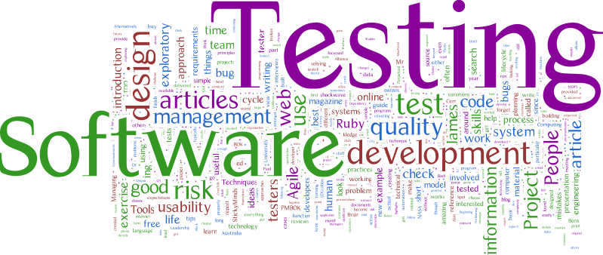
Software Testing
Software testing is widely used technology because it is compulsory to test each and every software before deployment.
Software testing is a process of identifying the correctness of software by considering its all attributes (Reliability, Scalability, Portability, Re-usability, Usability) and evaluating the execution of software components to find the software bugs or errors or defects
Laxman Gudivada
29-06-2022

Slide 2
Economics of Software Testing
The challenge facing any software development manager is how to balance the natural tension that exists between time, cost and quality. On top of this, Programes also have to balance the three Organisational elements of corporate strategy, delivery mechanisms for change and the business-as-usual environment. Quite a balancing act.
Relative cost of defects:
The following chart is a summary of the relative cost of fixing defects detected at various stages in the software development lifecycle process in a typical project. The cost of defect removal increases exponentially as the development lifecycle progresses. In addition, the later defects are found and fixed, the greater the risk to the business they pose.

Slide 3
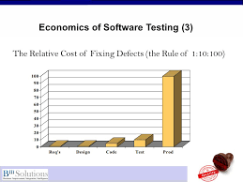
Defect insertion and detection points:
Defects are introduced to a system at a number of points during the software development lifecycle. The following chart is a model of a typical development lifecycle that illustrates the usual points of defect insertion and detection.
void quality shortcuts
- reduce rework and business impact costs
- Be realistic with scope within the constraints of cost and time tolerances
- Prioritise desired features and anticipated benefits
- Exercise rigour with requirements quality and clarity before committing to development
- Use risk-based prioritisation to focus efforts - work smart
- Ensure regular stakeholder engagement and feedback
- Enforce acceptance criteria and phase containment between test phases
- Adopt best practise testing methodology such as the SQS Vicars model

Slide 4

How Testing Is Conducted
Testing is based on external expectations - Internal behavior of the application is unknown. Testing is done on the basis of high-level database diagrams and data flow diagrams. Internal workings are fully known and the tester can design test data accordingly.
Principles of Testing:-
(i) All the tests should meet the customer requirements. (ii) To make our software testing should be performed by a third party. (iii) Exhaustive testing is not possible. As we need the optimal amount of testing based on the risk assessment of the application. (iv) All the tests to be conducted should be planned before implementing it (v) It follows the Pareto rule(80/20 rule) which states that 80% of errors come from 20% of program components. (vi) Start testing with small parts and extend it to large parts.

Slide 5
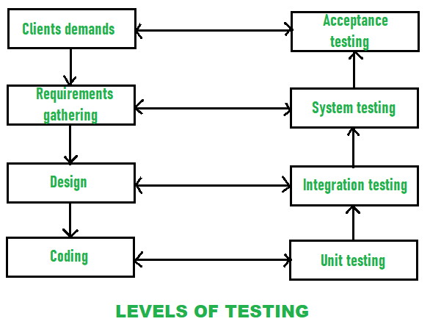
Steps To Complete Testing
1: Assess Development Plan and Status
2: Develop the Test Plan
3: Test Software Requirements
4: Test Software Design
5: Build Phase Testing
6: Execute and Record Result
7: Acceptance Test
8: Report Test Results
9: The Software Installation
10: Test Software Changes
11: Evaluate Test Effectiveness

Slide 6
Software Testing In Past
Developers used to write code, and when faced with an error would analyse and debug the issues. There was no concept of testing or testers. (However, in 1957, Charles L Baker distinguished program testing from debugging in his review of the book Digital Computer Programming by Dan McCracken.)
Software testing didn’t evolve in a single day; it took time and sweat to get it where it is today. Testing gurus like Hetzel and Dave Gelprin divide testing into five significant eras:
Debugging-oriented era:
This phase was during the early 1950s, when there was no distinction between testing and debugging. The focus was on fixing bugs. Developers used to write code, and when faced with an error would analyse and debug the issues. There was no concept of testing or testers. (However, in 1957, Charles L Baker distinguished program testing from debugging in his review of the book Digital Computer Programming by Dan McCracken.)
Demonstration-oriented era:
From 1957 to 1978, the distinction between debugging and testing was made and testing was carried out as a separate activity. During this era, the major goal of software testing was to make sure that software requirements were satisfied. As an example, the requirement might have been ‘We need a web application that displays a list of 10 products only’. Testers used to make sure that only 10 products were displayed. This failed because of the probability that a software’s function decreases as testing increases, i.e. the more you test, the more likely you'll find a bug. The concept of negative testing (or breaking the application) was not practiced in this era.

Slide 7
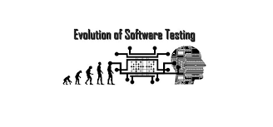
3.Destruction-oriented era:
From 1979 to 1982, the focus was on breaking the code and finding the errors in it. It was Glenford J. Myers who initially introduced the separation of debugging from testing in 1979 although his attention was on breakage testing. (‘A successful test case is one that detects an as-yet-undiscovered error.’) It illustrated the software engineering community’s desire to separate fundamental development activities, such as debugging, from verification. As an example, a tester would test software in such a way that it would break (e.g. entering letters in a field that should only accept numbers). There was no defect prevention approach during this phase. However, the destruction-oriented approach also failed because software would never get released because you could find one bug after another. Also, fixing a bug could also lead to another bug.
4.Evaluation-oriented era:
From 1983 to 1987, the focus was on evaluating and measuring the quality of software. Testing improved the confidence index on how the software was working. Testers tested until they reached an acceptable point, where the number of bugs detected was reduced. This was mainly applicable to large software.
5.Prevention-oriented era:
1988 to 2000 saw a new approach, with tests focusing on demonstrating that software met its specification, detecting faults and preventing defects. Code was divided into testable and non-testable. Testable code had fewer bugs than code that was hard to test. In this era, identifying the testing techniques was the key. The last decade of the 20th Century also saw exploratory testing, where a tester explored and deeply understood the software in an attempt to find more bugs.
***The early 2000s saw the rise of new concepts of testing like test-driven development (TDD) and behavioural-driven development (BDD). We’ll be highlighting these in upcoming articles.
****The year 2004 saw a major revolution in testing, with the advent of automation testing tools like Selenium. Likewise, API testing using tools like SOAP UI marked another turning point in the history of testing. These will be examined in detail in upcoming blogs.

Slide 8

Software Testing In Present
** In recent years, there has been a great evolution in the field of software testing with new trends coming into IT industry services. The introduction of new technologies has brought the latest updates in software design, development, testing, and delivery. The top priority of businesses across the globe is cost optimization. In doing so, most of the IT leaders believe in the integration of the latest IT techniques for their organization.
** Digital transformation is another important point of focus for the industries and the businesses that are ranking high on cloud computing and business analytics.Factors like quality and reliability are being given major attention, which results in the reduction of software application errors, improving the security and application performance.
Here are major trends for 2022 that are changing the face of software testing:
1. UAT (Acceptance Testing)
2. DevOps
3. Regression Testing
4. Automation Testing
5. Integration Testing
6. User Testing
7. Accessibility Testing
8. Performance Testing
9. Selenium Testing
10. Scriptless Test Automation:
11. Artificial Intelligence:
12. Robotic Process Automation (RPA):
13. Infrastructure as Code (IaC):

Slide 9




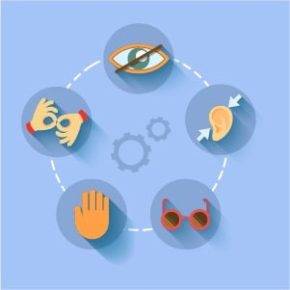
1. UAT (Acceptance Testing):
As soon as a product is developed, even before it is moved to production, the product owner will check its functionality and usability by performing the User acceptance testing.
2. DevOps:
DevOps is a widely known practise of bringing development and operations teams together to bring an effective DevOps culture. This DevOps culture is about a shared collaboration between the development (Dev) and operation (Ops) teams.
→In Software testing, it is important that every system component gets integrated with the different application modules to ensure smooth working of the entire system. Enterprises following agile and DevOps should take up integration testing to ensure that the application modules function effectively when they are grouped together.
→Thus, Integration testing should be leveraged by businesses as there are numerous benefits with it such as the process helps to identify system-level issues such as module integration issues, broken databases, etc. and helps to identify them while developers resolve them at the earliest. Explore the benefits businesses get with Integration Testing.

Slide 10
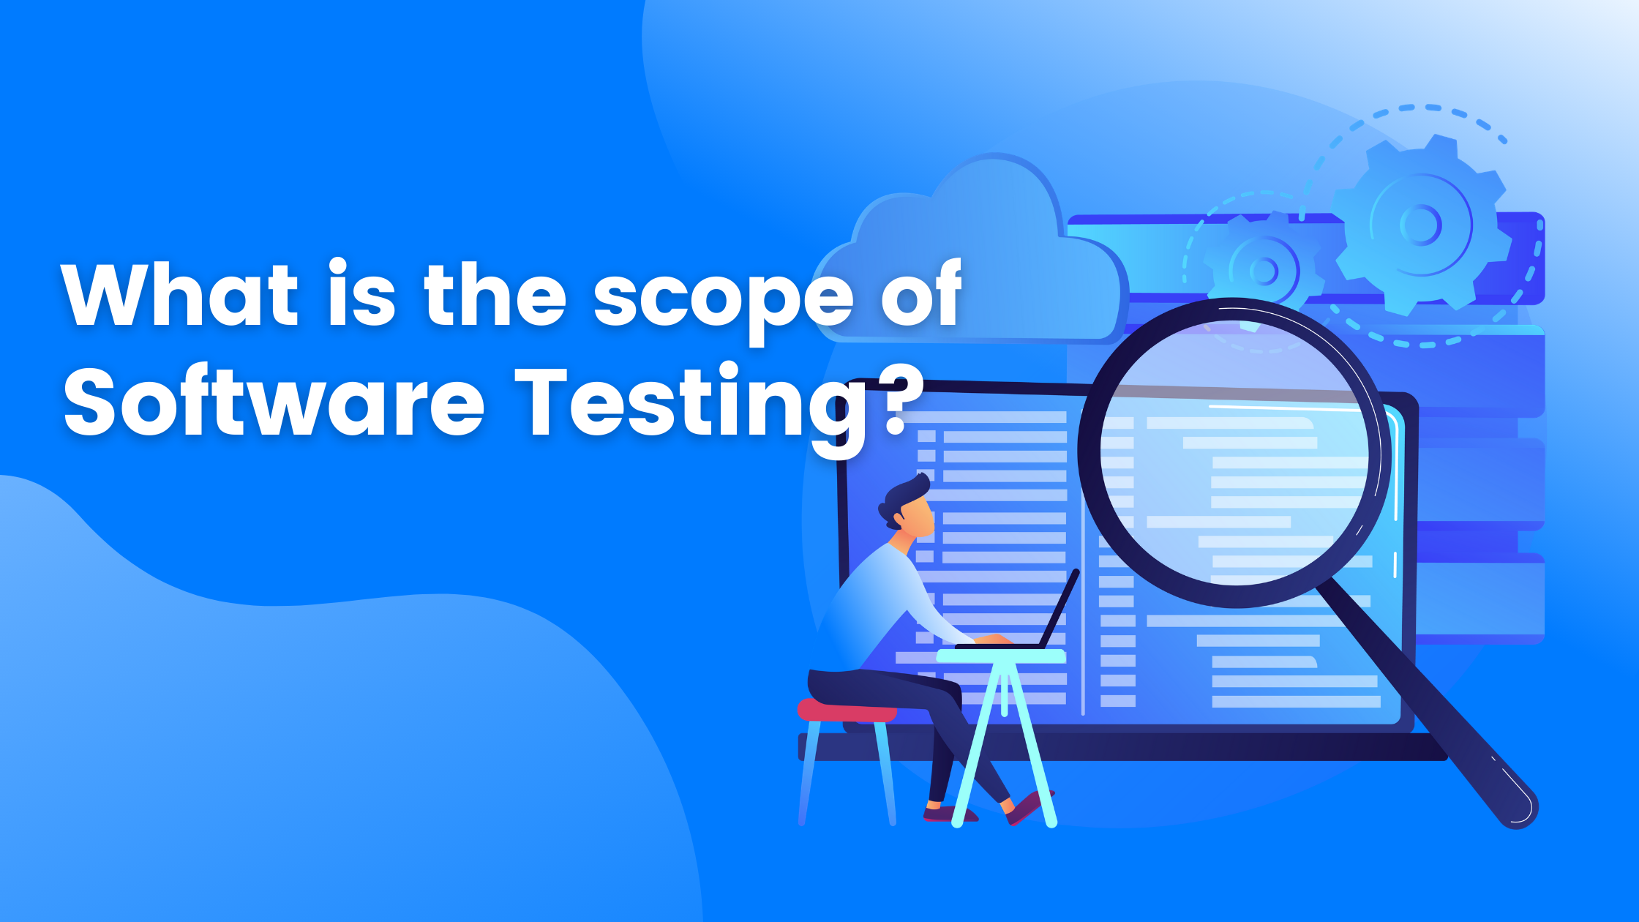
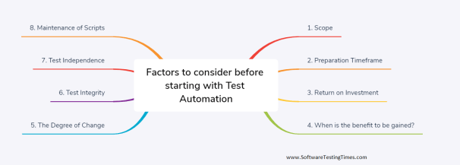
Factors Influencing The Scope Of Software Testing
Planning. Planning in software testing is essential.
Time. As there are some projects where time pressure takes place, it is important to be careful with test estimation.
Size & Complexity.
Documentation.
Skills.
Team interaction.
Methodology.
Trends.

Slide 11
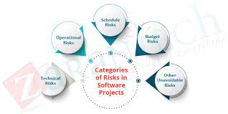
Risks In Software Testing
→ In software testing Risks are the possible problems that might endanger the objectives of the project stakeholders. It is the possibility of a negative or undesirable outcome. A risk is something that has not happened yet and it may never happen; it is a potential problem.
→ In the future, a risk has some probability between 0% and 100%; it is a possibility, not a certainty.
We can classify risks into following categories:
Product risk (factors relating to what is produced by the work, i.e. the thing we are testing).
Project risk (factors relating to the way the work is carried out, i.e. the test project)

Slide 12
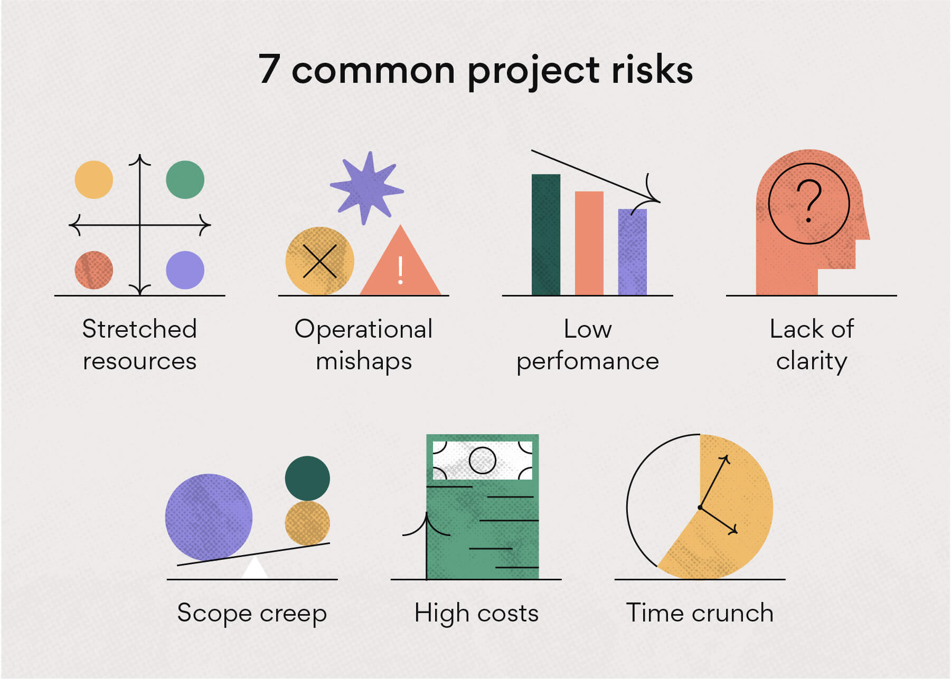
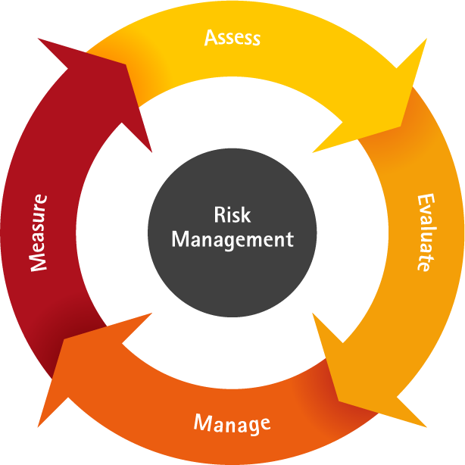
Project Risks
Technology risk. The technological aspect of running a project is a complex deliverable because there is a high turnover of new and advanced technologies.
Communication risk.
Scope creep risk.
Cost risk.
Operational risk.
Skills resource risk.
Performance risk.
Market risk.

Slide 13
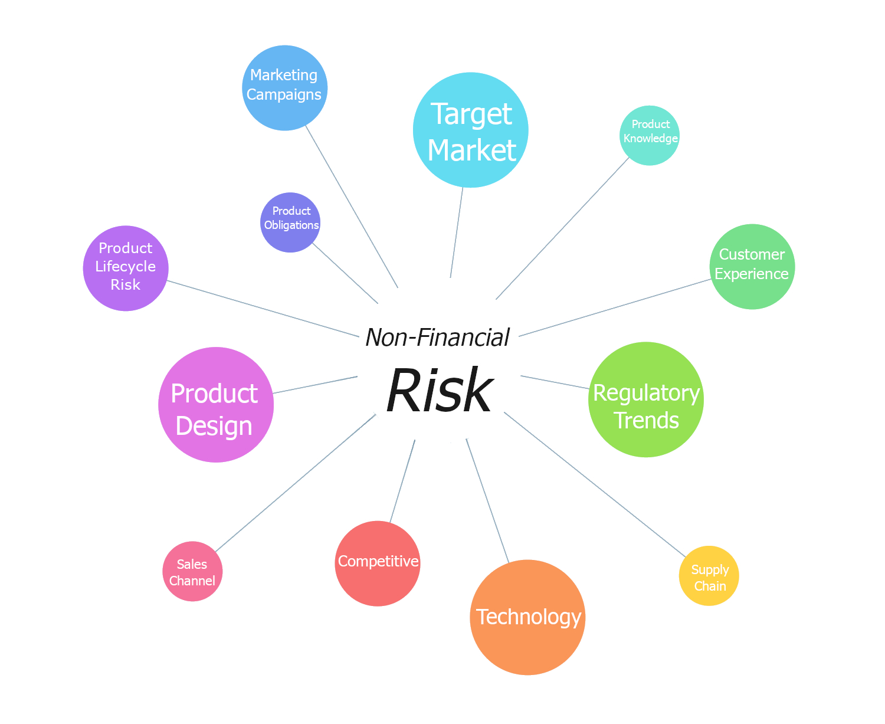
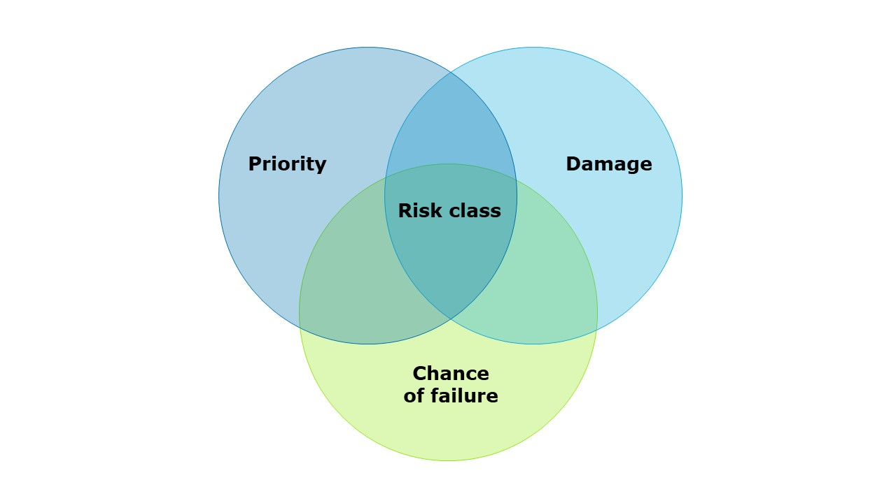

Product Risks
Product risk is the set of things that could go wrong with the service, software or whatever is being produced by the project. In the same way that project and business risks are quantified (using likelihood and impact) product risks should also be categorised and measured.
The Four Big Risks:
value risk (whether customers will buy it or users will choose to use it)
usability risk (whether users can figure out how to use it)
feasibility risk (whether our engineers can build what we need with the time, skills and technology we have)
business viability risk (whether this solution also works for the various aspects of our business)

Slide 14
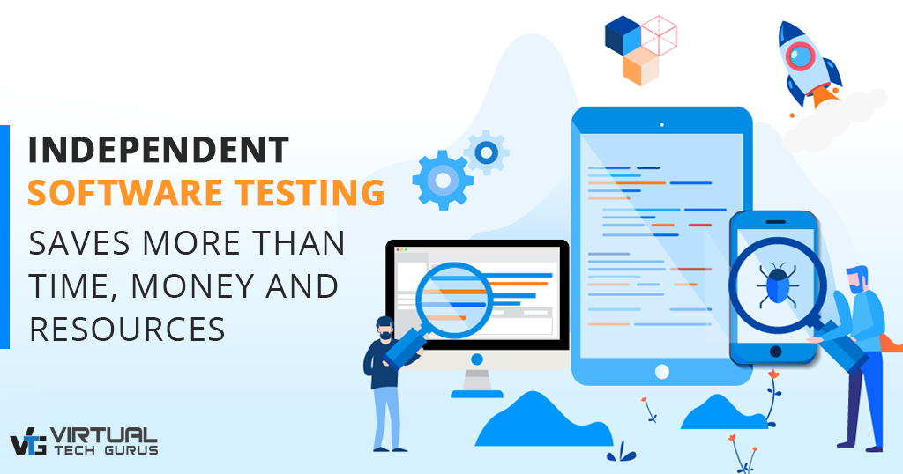
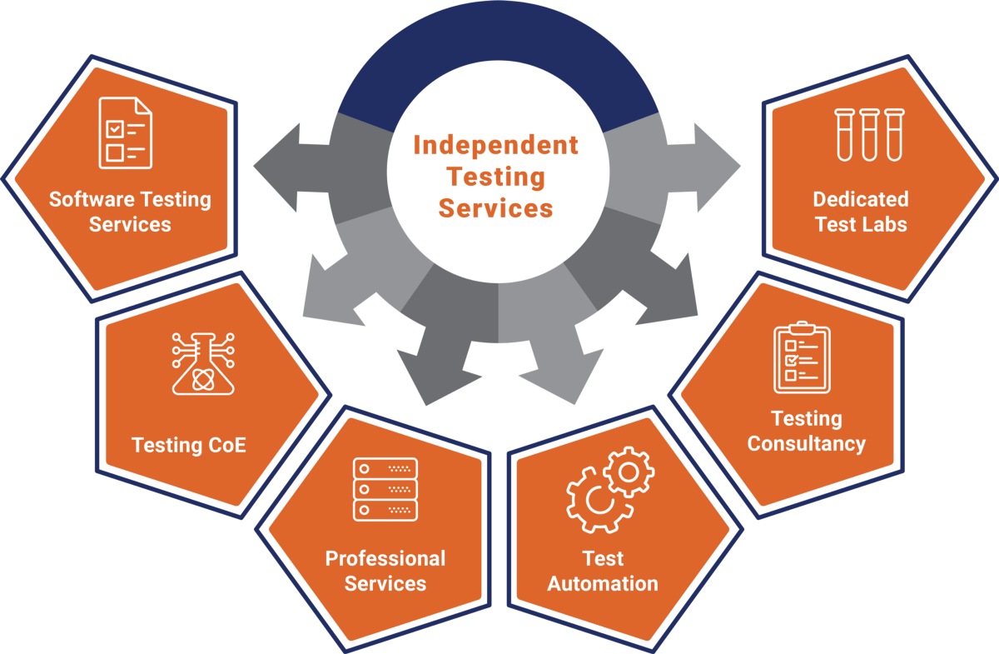
Need Of Independent Software Testing
→ An independent testing team gives an impartial, third-party view of the software leading to efficient and uninfluenced (assumption-free) testing that meets customer expectations. Independent testing finds more defects compared to testing performed by the project team.
Levels of Independent Testing:
Testing done by developer himself
Independent testers ceded to the development team
Independent Testing Team within Organization
Independent Testers of different Organization
Outsourced test team members of other organization
Benefits:
The tester sees each defect in a neutral perspective
The tester is totally unbiased
The tester sees what has been built rather than what the developer thought
The tester makes no assumptions regarding quality

Slide 15
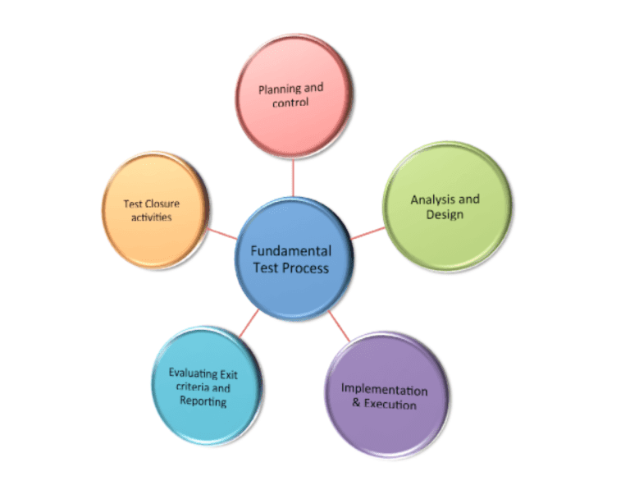
Activities In Fundamental Test Process
Test Planning and Control.
Test Analysis and Design.
Test Implementation and Execution.
Evaluating Exit Criteria and Reporting.
Test Closure.
Planning :
Defining testing objectives
Test activities specified to meet the objectives and goals
Planning determines scope, risks, test approach, test strategy.
Control :
Continuous ongoing activity to compare actual progress with plan
Measure , analyse and report the status, including deviations from plan
Initiate necessary actions to meet objectives
You can’t control testing without monitoring.Planning takes into account feedback from monitoring and control

Slide 16

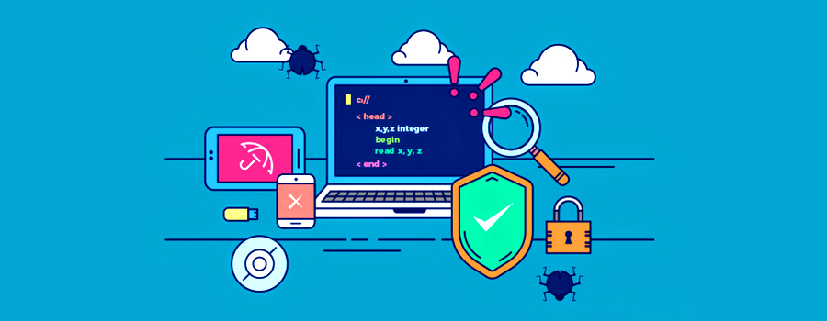
Analysis and Design:
Review the test basis and understand the software specifications (such as requirements, architecture, design and interface)
Evaluate test-ability of requirements to specify expected results and make sure requirements can be verified.
Identify and prioritize Test conditions
Design high level test cases and prioritize
Identify test data
Design test environment and identify any tool or infrastructure required for testing the software.
Create bi-directional traceability between test basis and test cases
Test Implementation and Execution:
Develop and prioritize tests cases
Develop test procedures , test suites( logical collection of test cases)
Create test data
Set up test environment and verify that it is ready for test execution
Verify and update traceability
Execute test procedures
Log the outcome of each execution and compare actual with expected results
Report discrepancies and provide additional information to establish if likely cause is defect in code, test data, test document

Slide 17
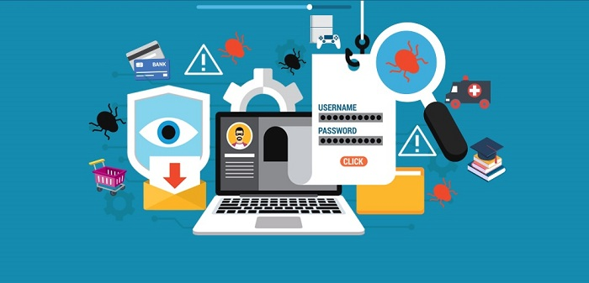
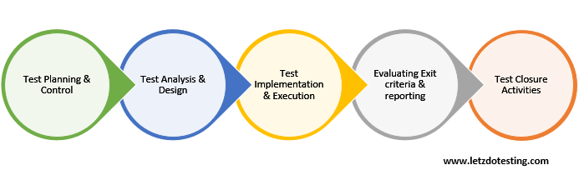
Evaluating test exit criteria and Reporting:
Check test logs against exit criteria in test planning and identify what is remaining to test or fix
Assess if more tests are needed or if the initial exit criteria needs to be modified
Write a test summary report for stakeholders
Test Closure Activities:
Ensure that planned deliverable has been delivered.
Ensure Incident reports are resolved or marked deferred
Documenting acceptance of the system
Finalize and archive test ware, test environment and infrastructure for reuse
Hand over test ware to maintenance team
Evaluate lessons learnt to determine changes needed for future releases and projects Use information gathered to improve test maturity

Slide 18
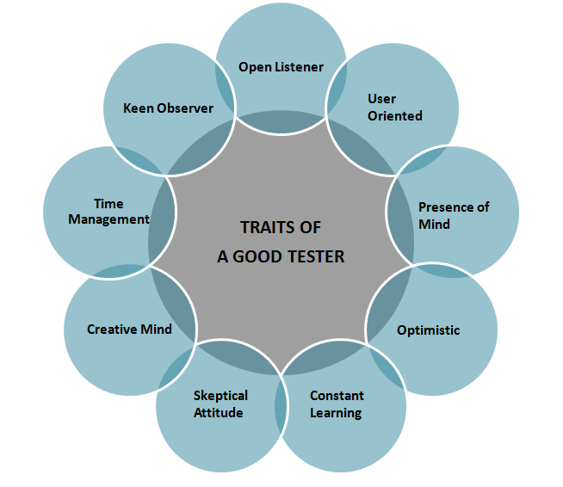
Attributes Of A Good Software Tester
→Testers are the backbone of any IT company as they are the ones who can give the quality outcome and they are most responsible for releasing a project too.
→This tutorial explains the most important characteristic features that a great Software Tester must possess.
Characteristics Of A Great Software Tester:
1. Be Skeptical.
2. Don't Compromise On Quality.
3. Ensure End-User Satisfaction.
4. Think from the Users Perspective.
5. Prioritize Tests.
6. Never Promise 100% Coverage.
7. Be Open to Suggestions.
8. Start Early.
Finally, Be a Good Observer:
Observe things happening around you. Keep track of all major and minor things in your project. Observe the way of developing the code, types of testing and its objectives. Observe and understand the test progress and make the necessary changes if it is off track in terms of schedule or testing activities.
This skill will essentially help you to keep yourself updated and get ready for the course of action for any situation.

Slide 19

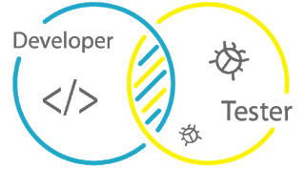
Psychological Of Software Testing
Software development, including software testing, involves human beings. Therefore, human psychology has important effect on software testing.
→ In software testing, psychology plays an extremely important role. It is one of those factors that stay behind the scene, but has a great impact on the end result. Categorized into three sections, the psychology of testing enables smooth testing as well as makes the process hassle-free. It is mainly dependent on the mindset of the developers and testers, as well as the quality of communication between them. Moreover, the psychology of testing improves mutual understanding among team members and helps them work towards a common goal.
The three sections of the psychology of testing are:
The mindset of Developers and Testers.
Communication in a Constructive Manner.
Test Independence.

Slide 20
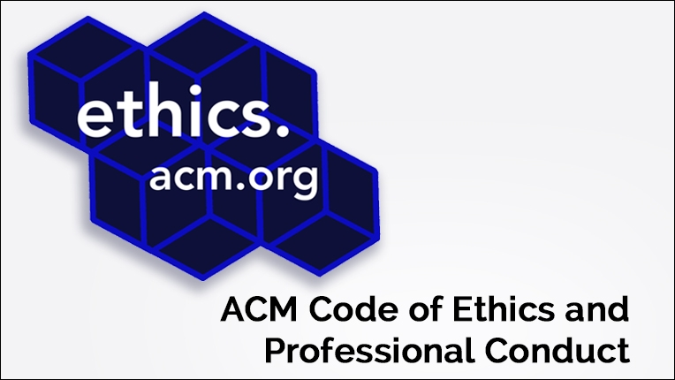
Code Of Ethics
In software testing there are numerous rules and regulations that ought to be followed by software engineers to maintain the credibility of the software as well as to make it suitable according the universal standards.
Types of Code of Ethics in Testing:
While performing software testing, testers should commit themselves in making analysis, finding defects, monitoring the process of testing, reporting defects & bugs, maintaining the software, among other things in a respected and beneficial manner.

Slide 21
Public:
During the process of software development and testing, the public interest and benefit should be considered before corporate and personal gain. They should consistently act in the interest of the public.
2.Client & Employer:
Apart from public interest, the testers should consider the interest of their client and employer while conducting tests on the software. They should act according to the requirements of their clients and should fulfill all their needs.
3.Product:
The most important factor that needs consideration during the process of software testing is the product itself. The testers should perform their tasks while ensuring that the deliverable is of best quality and has exceptional effectiveness. Also, make sure that all deliverables on the product are in compliance the stated standards.
4.Judgement:
The testes should maintain integrity and independence while making judgments regarding the process of testing or any other aspects related to it.
5.Management:
Here, the team managers and leads should take the responsibility and ethical steps to manage the process of software testing, development, and maintenance. This will help them avoid any confusion as well as allow them to test each component of the software accurately.
6.Profession:
The team of testers should follow the set f values, principles, and standards and advance the integrity of their profession.

Slide 22
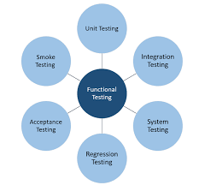
Testing Limitations In Testing
Exhaustive (total) testing is impossible in present scenario.
Time and budget constraints normally require very careful planning of the testing effort.
Compromise between thoroughness and budget.
Test results are used to make business decisions for release dates.
Even if you do find the last bug, you’ll never know it
You will run out of time before you run out of test cases
You cannot test every path
You cannot test every valid input
You cannot test every invalid input
You cannot test a program completely
We can only test against system requirements
Testing cannot be done against system requirements. We also cannot detect any errors in requirements or ambiguous requirement leads the complete testing process to inadequate testing.
When it comes to major constraints like Time & Budget, it requires attentive planning of test effort. Mostly, we compromise in between thoroughness and budget at the time of testing.

Slide 23


